Slide 1
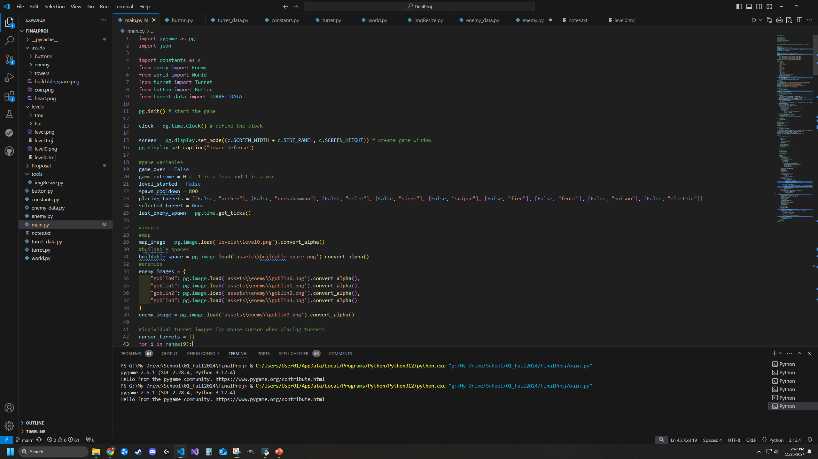
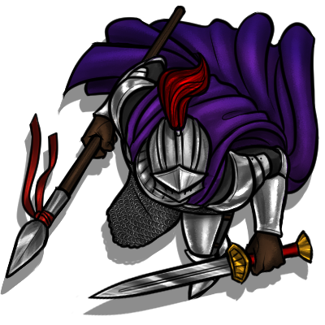
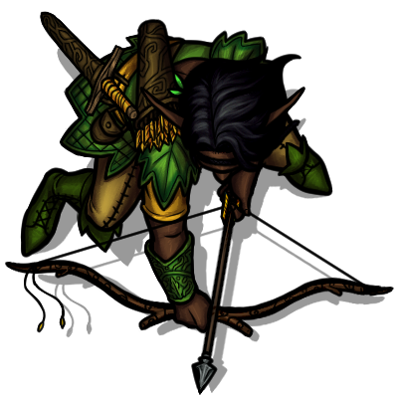
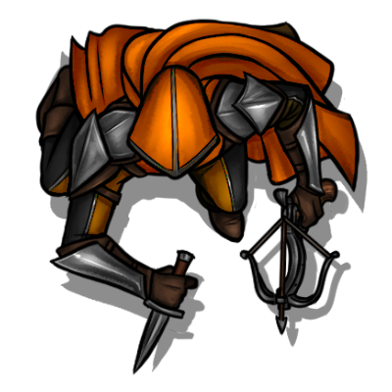


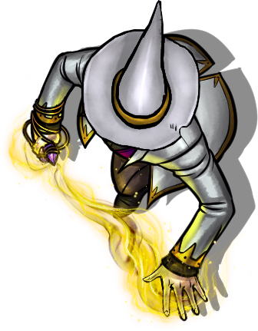
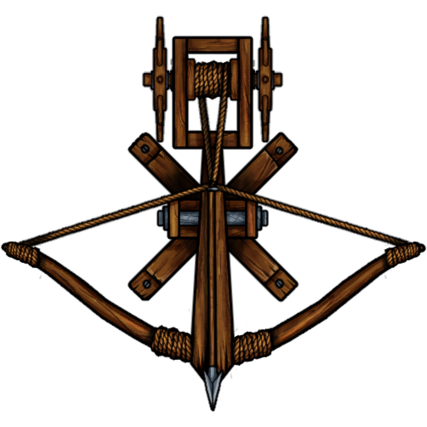
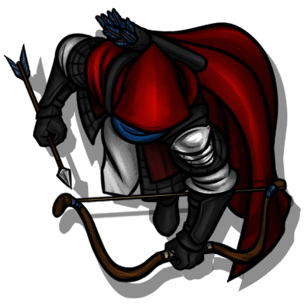
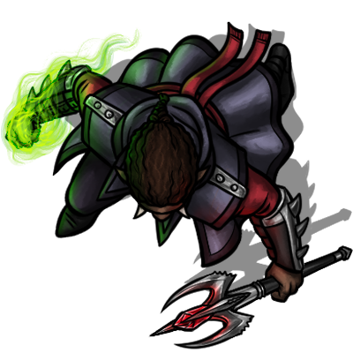
CS 210: Final Project Proposal
Mason Leavitt
Fall 2024
TOWER DEFENSE
Implemented with Pygame

Slide 2
Introduction
I always loved the old tower defense games from the 90s and early 2000s. Sadly, I don’t see people making them now days, so I’ve begun creating one for this project.
Main Objectives:
At least two maps, MANY waves of enemies, 1 set of towers (9 different towers in the set), four upgrades per tower, and player resources.
Stretch Goals
Multiple maps, additional sets of towers, selection marquee, audio, save states, score history, highscores.

Slide 3
Data Structures/Algorithms and Usage
Lists
Map tiles (array)
Enemy movement waypoints (arrays/List/Sets)
Collections of images
Collections of buttons
Deque/Stack/Queue
Undo system (Ctrl+z)
Hash Table
Tower properties
Tower upgrades
Enemy properties
Tree
Choose which type of enemy to fight next based on a randomly generated tree at runtime
Graph
Allow for random pathing for a special enemy type via an adjacency list
Searching
Linear search to check buildable tiles
Sorting
High scores (stretch goal)
GUI
Pygame
Free and paid assets
Custom assets created/modified in GIMP
TILED utility
Audacity sound editor

Slide 4
UML
World
Turret
+level: int
+game_speed: int
+waypoints: list
+lives: int
+money: int
+tile_map: list
+level_data: dict/JSON
+map: .png
+enemies_created: int
+enemies_killed: int
+enemies_missed: int
+enemy_list: list
+type_data: dict
+upgrade_level: int
+upgrade_limit: int
+original_img: PG Surface
+image: PG Surface
+angle: int
+range: int
+cooldown: int
+update_time: int
+last_shot: int
+rect: Pygame (PG) Rect
+tile_x: double
+tile_y: double
+x: double
+y: double
+selected: bool
+range_ring: PG Surface
+range_rect: PG Rect
+target: Enemy
+process_data()
+process_enemies()
+check_level_complete()
+reset_level()
+draw_map(
Enemy
+update()
+draw()
+targeting()
+upgrade()
+type: string
+position: PG Vector2
+base_hp: int
+hp: int
+speed: list
+angle: int
+original_img: PG Surface
+image: PG Surface
+rect: PG Rect
+waypoints: list
+target_waypoint: int
+target: PG Vector2
+movement: PG Vector2
Button
+image: .png
+rect: Pygame (PG) Rect
+clicked: bool
+single_click: bool
+draw_button()
+update()
+move()
+rotate()
+draw_hp()
+check_alive()

Slide 5
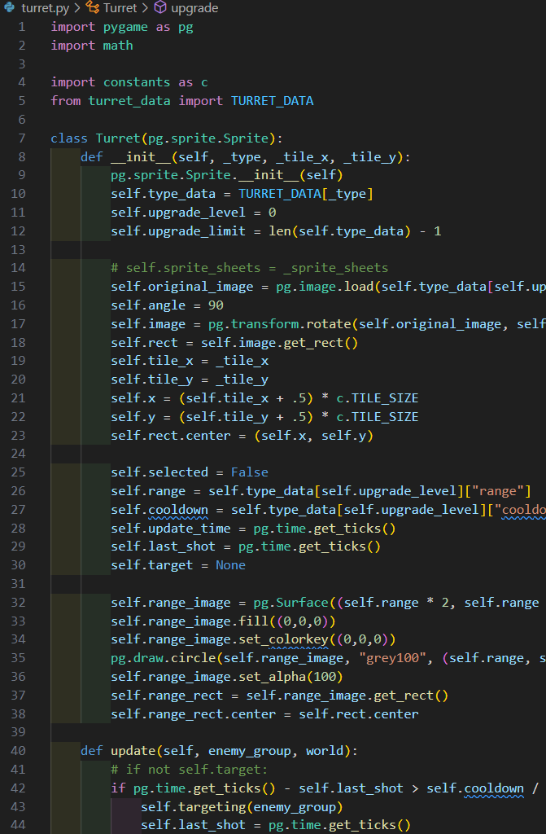
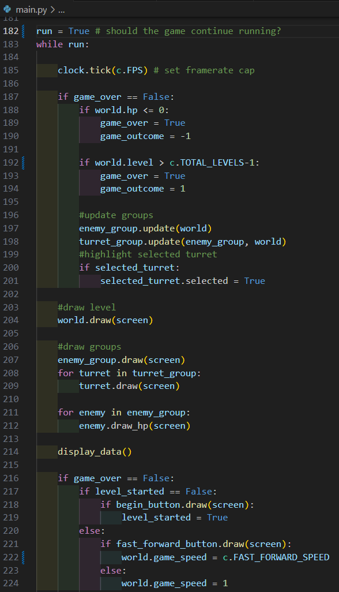
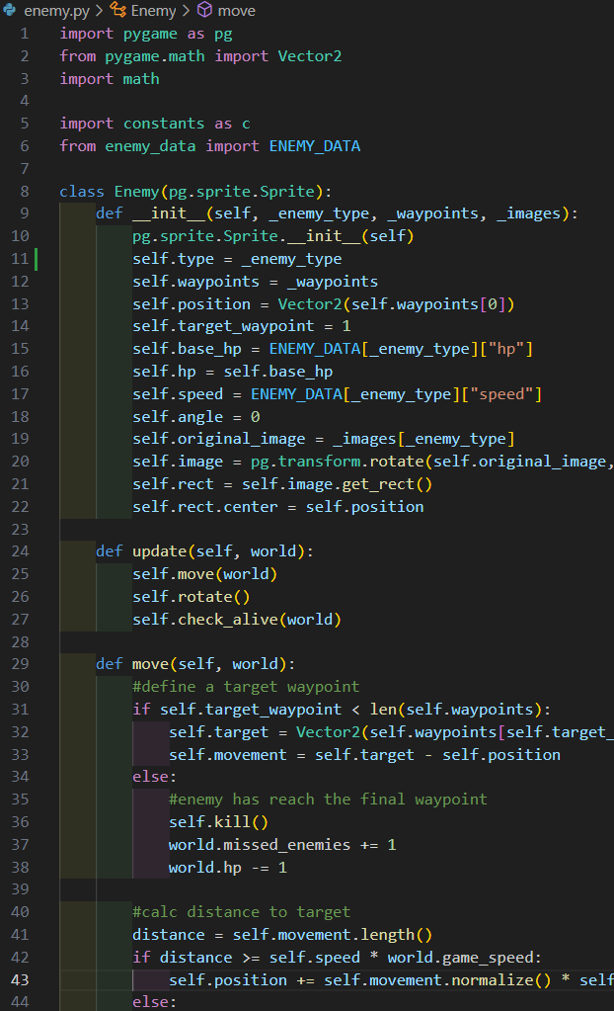
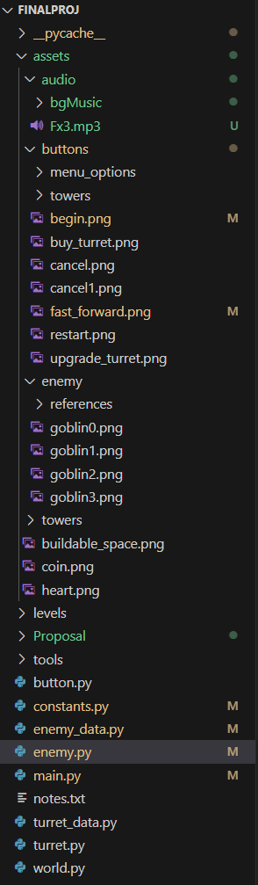
Code Samples

Slide 6
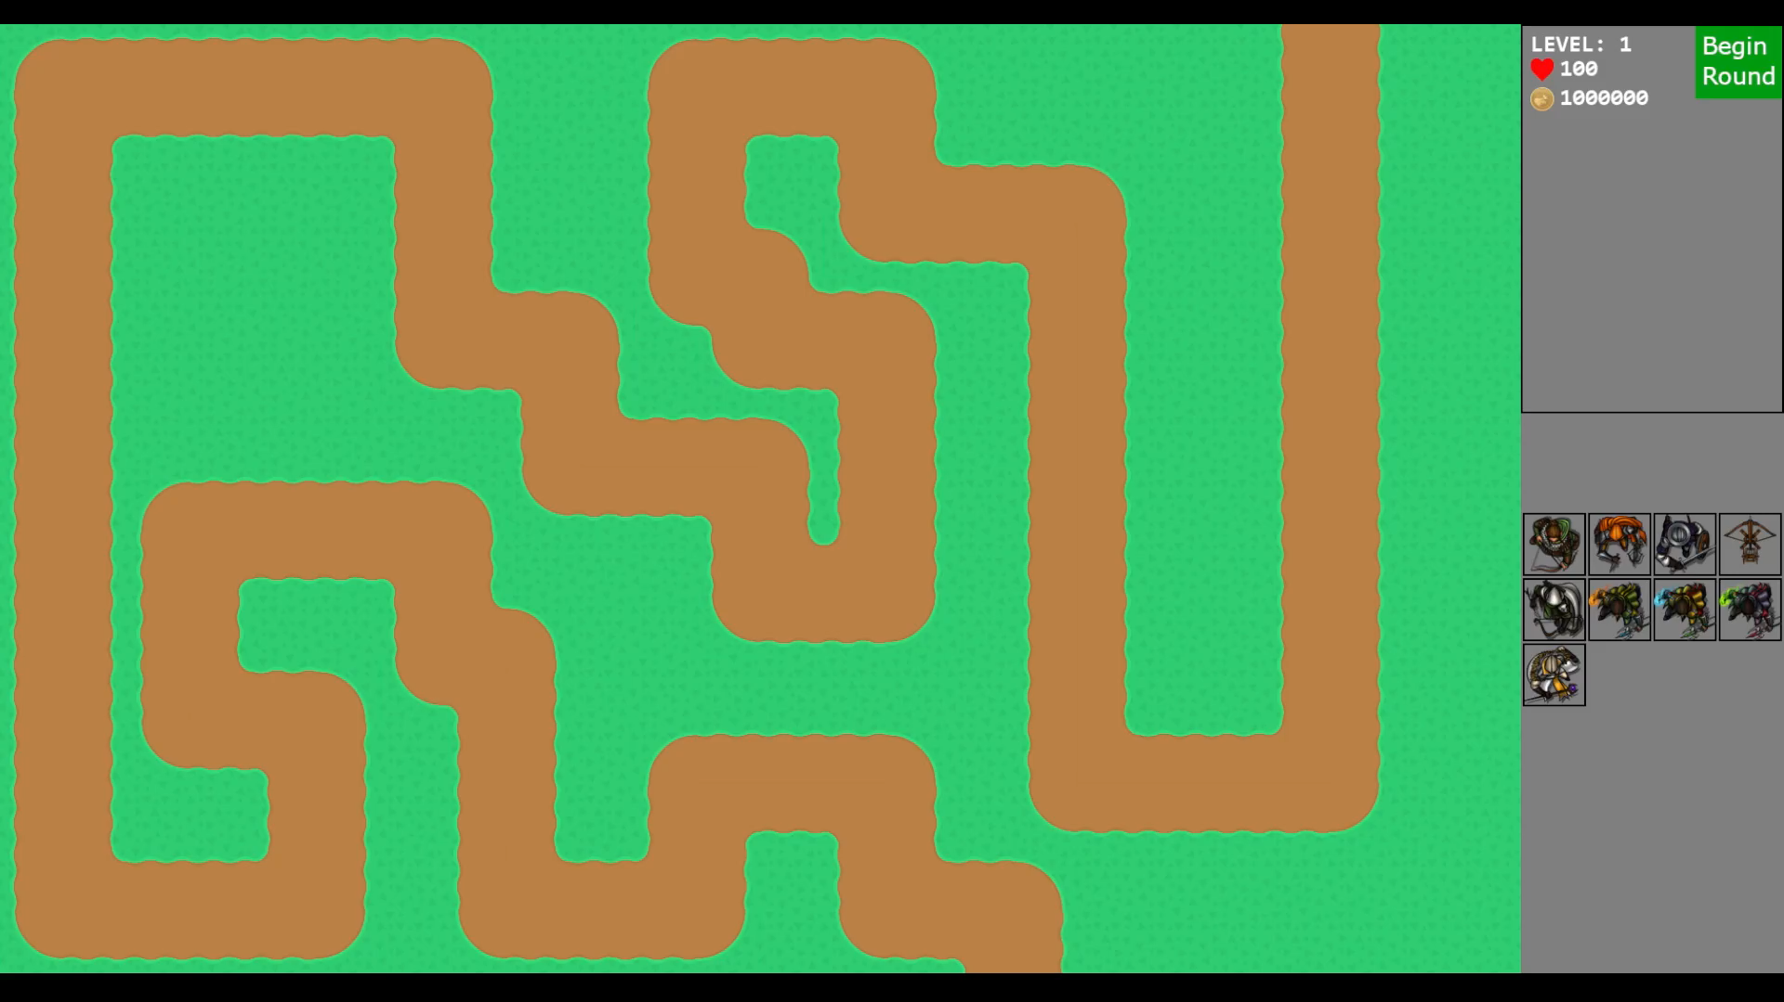
UI via Pygame
Game Window
Side Panel
Game Screen
Game Screen
Base map image
Enemy movement path
Buildable tile indicators
Appears when placing towers
Built towers
Enemies
Toggleable tower ranges
Side Panel
Game data (current level, lives, money)
Begin round button
Fast-forward button
Buy-Tower grid
Tower info display (in development)
Sell tower (in development)
*More additions likely as development continues
Continue to see current UI implementation

